Slide 1


Grant Miller
12/16/2024

Slide 2

Outline
Executive Summary
Introduction
Methodology
Results
Conclusion
Appendix

Slide 3
Executive Summary
Methodologies:
Data collection: API and Web Scraping.
Data cleaning in Python (e.g. Pandas, Numpy).
Exploratory data analysis in SQL for structure and trends.
Visualizations using Python (Matplotlib) to find patterns.
Machine learning prediction of successful landings.
Results:
Interactive geospatial map with Folium showing launch site locations.
Predictive model of landing success.

Slide 4
Introduction
SpaceX advertises Falcon 9 rocket launches on its website, with a cost of 62 million dollars; other providers cost upward of 165 million dollars each, much of the savings is because SpaceX can reuse the first stage. Therefore if we can determine if the first stage will land, we can determine the cost of a launch. This information can be used if an alternate company wants to bid against SpaceX for a rocket launch.
Questions to answer:
What are the key factors of a successful first stage landing?
How do these key factors interact against other variables to determine a successful landing?
What conditions ensure a successful landing?

Slide 5

Section 1

Slide 6
Methodology
Executive Summary
Data collection methodology:
API and Web Scraping was used to collect and import data into Python.
Perform data wrangling
Continuous variables nulls replaced with mean, Categorical variables used one hot encoding.
Perform exploratory data analysis (EDA) using visualization and SQL
Perform interactive visual analytics using Folium and Plotly Dash
Perform predictive analysis using classification models
How to build, tune, evaluate classification models.

Slide 7
Data Collection
Webscraping:
Requets, Pandas, Numpy, BeautifulSoup and Datetime used in Visual Studio Code for Windows
Helper functions to better extract data from .json() and create a dataframe (Pandas)
Used request to get URL
Tables extracted with find_all()
Table selected with html_tables[]
Dictionary to create landing for selected tables
Pandas used to convert to table
API:
Requests, Pandas, Numpy, and Datetime used in visual Studio Code for Windows
Requests used to connect to SpaceX API for past launches
Reponse decoded as .Json() and converted to Pandas dataframe with .json_normalize()
Returned ID codes defined with second API connection to create labels
Final data table constructed by combining columns into the dictionary and converted to a data frame with Pandas

Slide 8
Data Collection – Web Scraping
Web scrap Falcon 9 launch records from Wikipedia using BeautifulSoup and Pandas for a data frame.
Notebook Link: IBM-DS-SpaceX-Capstone/IBM DSData Collection Web Scraping.ipynb at main · GmillerII/IBM-DS-SpaceX-Capstone
Use BeautifulSoup to create an object from the response.
Parse data with find_all() for desired tables.
Iterate through elements for <th> and extract column names.
Request() Falcon 9 Wiki Page.
Remove annotation noise and standardize formats.
Append data to predefined data dictionary.
Find all wikitable "plainrowheaderscollapsible" and iterate over tables looking for <th> for header cells, confirm content of <th> exists, confirm data type is digit for continuous variables and rows..find_all() on <td> for data within current row.
Map the table data to the dictionary keys.
Convert dictionary to a data frame and check for data completeness.

Slide 9
Data Collection – SpaceX API
Define helper functions for API to extraction API information using ID's in the data.
Use requests.get() to call API and append data to the list and test the connection.
Decode response using .json() and turn into a data frame using Panda's .json_normalize().
Fetch additional data using helper functions and add them to list.
Combine list into a dictionary, then create the dataframe with Pandas.
Filter for Falcon 9 launches only where Booster Version equals "Falcon 9".
Replace missing continuous data with mean for PayloadMass and LandingPad.
Save data to a .csv.
Notebook Link: IBM-DS-SpaceX-Capstone/IBM DS Data Collection API.ipynb at main · GmillerII/IBM-DS-SpaceX-Capstone

Slide 10
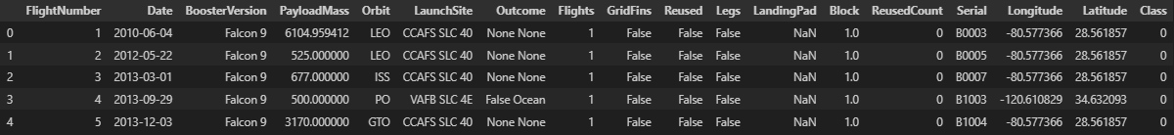
Data Wrangling
Data was processed using Pandas and Numpy.
Reviewed value_counts() on LaunchSite, Orbit and count of mission outcome by orbit.
Create landing outcome label from Outcome column and bad_outcomes sub set.
Bad outcomes were considered the following distinct values "None None", "False ASDS', "False Ocean", "None ASDS", "False RTLS"S.
Determined overall success rate with new label was 66%.
Notebook Link: IBM-DS-SpaceX-Capstone/IBM DS Data Wrangling.ipynb at main · GmillerII/IBM-DS-SpaceX-Capstone

Slide 11
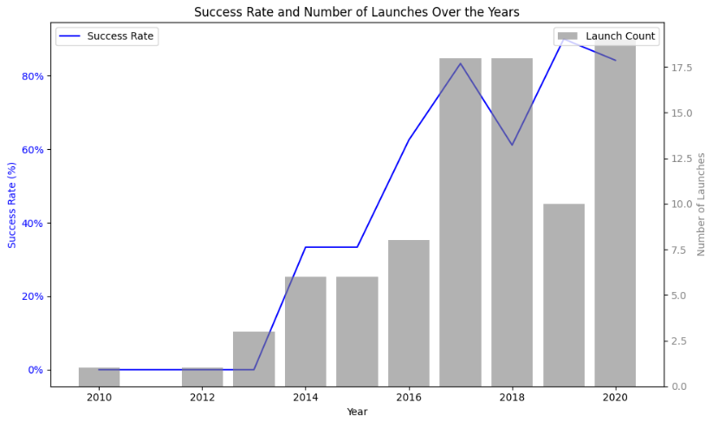
EDA with Data Visualization
Scatter Plots were used for the various measures for relationships between Flight Number and Payload Mass, Flight Number and Launch Site, Payload Mass vs Launch Site, Flight Number vs Orbit Type, Payload vs Orbit Type
Bar Chart was used for Success Rate by Orbit Type to find trends between sites
Line chart was use to trend successful launches by year to determine if there were improvement in success rates over time.
Notebook Link: IBM-DS-SpaceX-Capstone/IBM DS EDA Visualizations.ipynb at main · GmillerII/IBM-DS-SpaceX-Capstone

Slide 12
EDA with SQL
Task 1: Retrieve unique launch sites.
Task 2: Filter records where launch sites start with 'CCA'.
Task 3: Calculate total payload mass for NASA (CRS) missions.
Task 4: Find the average payload mass for booster version 'F9 v1.1'.
Task 5: Identify the date of the first successful ground pad landing.
Task 6: List boosters with drone ship success and payload between 4000-6000 kg.
Task 7: Count total successful and failed mission outcomes.
Task 8: Find booster versions carrying the maximum payload mass.
Task 9: Display failure outcomes in 2015, including months and launch details.
Task 10: Rank landing outcomes by count (2010-2017).
Notebook Link: IBM-DS-SpaceX-Capstone/IBM DS EDA SQL.ipynb at main · GmillerII/IBM-DS-SpaceX-Capstone

Slide 13

Build an Interactive Map with Folium
Map Objects Created
Launch Site Markers:
Markers for CCAFS LC-40, CCAFS SLC-40, KSC LC-39A, and VAFB SLC-4E with site names.
Reason: Clearly identifies launch sites for analysis.
Launch Site Circles:
1000m radius circles around each site.
Reason: Highlights surrounding areas for proximity context.
Success/Failure Markers:
Color-coded markers (Green: Success, Red: Failure) for each launch.
Reason: Simplifies success rate analysis.
Key Insights:
Launch sites are near the equator and coastlines for efficiency and safety.
Interactive features enhance usability and exploration.
Notebook Link: IBM-DS-SpaceX-Capstone/IBM DS Folium Maps.ipynb at main · GmillerII/IBM-DS-SpaceX-Capstone
Map Objects Created:
Mouse Position Plugin:
Dynamic display of latitude and longitude on hover.
Reason: Pinpoints coordinates for measurement.
Distance Lines (Optional):
PolyLines to visualize distances to coastlines/landmarks.
Reason: Assesses proximity to key geographical features.

Slide 14
Build a Dashboard with Plotly Dash
Plots/Graphs Added:
Success Pie Chart: Displays the total number of successful launches for a selected site or all sites. Reason: Helps visualize the success rate of launches by site.
Payload Success Scatter Plot: Shows the correlation between payload mass and launch success. Reason: Allows users to analyze how payload size impacts launch outcomes.
Interactions Added:
Dropdown for Launch Site Selection: Users can select a specific launch site or view data from all sites. Reason: Customizes the dashboard for site-specific analysis.
Payload Range Slider: Filters the scatter plot by payload mass range. Reason: Provides dynamic control over payload data for more granular analysis.
Python Link: IBM-DS-SpaceX-Capstone/Dashboard with Ploty Dash.py at main · GmillerII/IBM-DS-SpaceX-Capstone

Slide 15
Predictive Analysis (Classification)
Data Collection: Data loaded from two CSV files.
EDA: Seaborn and Matplotlib used to visualize features and identify class variable.
Data Preprocessing: Engineered features, standardized data, then split into training and test sets.
Model Selection & Tuning: Evaluated models (Logistic Regression, SVM, Decision Tree, Knn)) by using GridSearchCV for hyperparameter tuning.
Model Evaluation: Reviewed performance using confusion matrix, precision, recall, and cross validation.
Model Selection: Choose the model with the highest accuracy and recall based on evaluation metrics
Notebook Link: IBM-DS-SpaceX-Capstone/IBM DS Prediction Modeling.ipynb at main · GmillerII/IBM-DS-SpaceX-Capstone

Slide 16
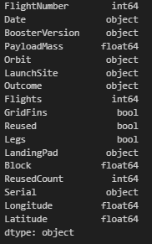
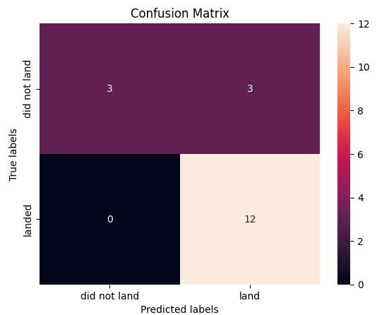
Results
Exploratory data analysis results:
Seaborn and matplotlib to visualize correlation and feature distribution.
Class variable identified as the targets which represents a successful landing.
Predictive analysis results
The best performing model was selected based on the accuracy and recall matrics.
Confusion matrix, precision, recall, and cross-validation sued to access models prediction capabilities.

Slide 17

Section 2

Slide 18
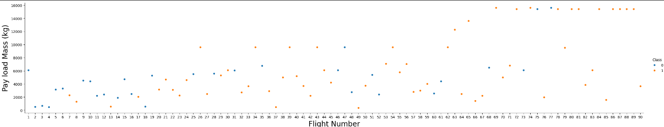
Flight Number vs. Launch Site
After reviewing the plot, the instances of successful flights increased as flight number increase.

Slide 19
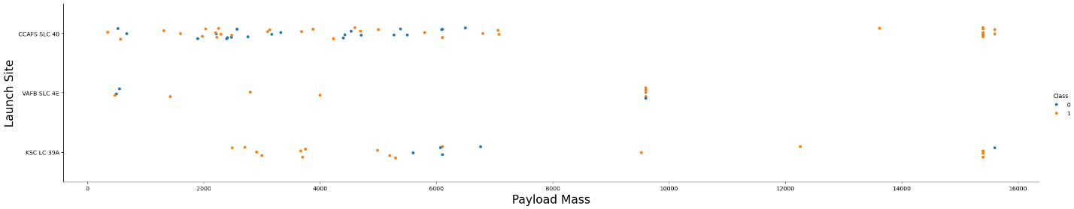
Payload vs. Launch Site
Instances of a successful flight increased as Payload Mass increased.

Slide 20
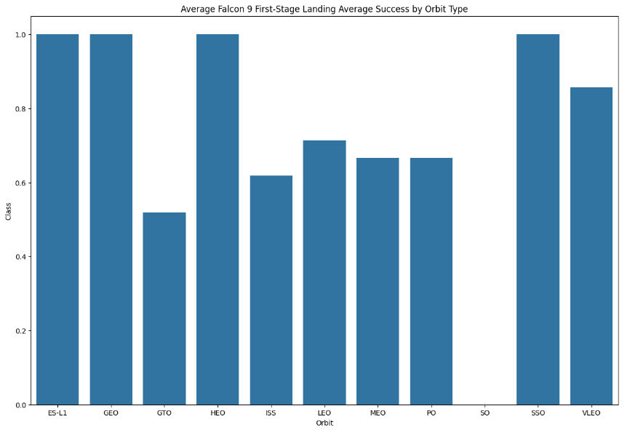
Success Rate vs. Orbit Type
Higher orbit launches has a higher chance of a having a successful landing.

Slide 21
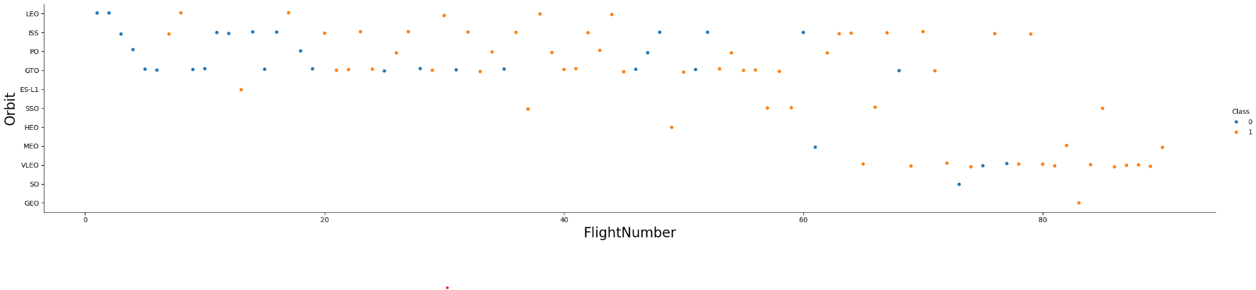
Flight Number vs. Orbit Type
Lower orbit launches had a harder time of achieving a successful landing.

Slide 22
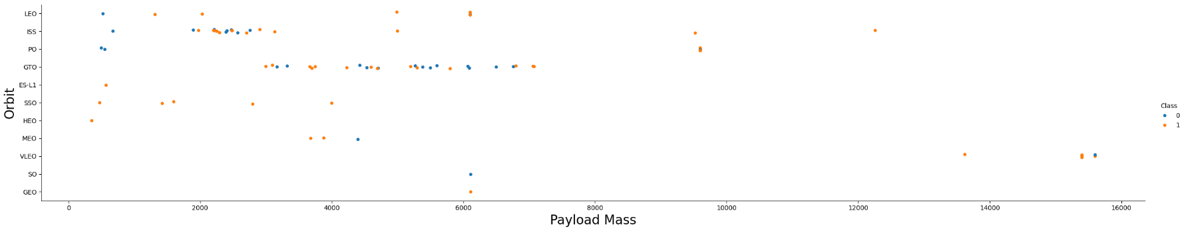
Payload vs. Orbit Type
Heavier payloads fared better than lower payload mass but why these outcomes happened need investigated further.

Slide 23
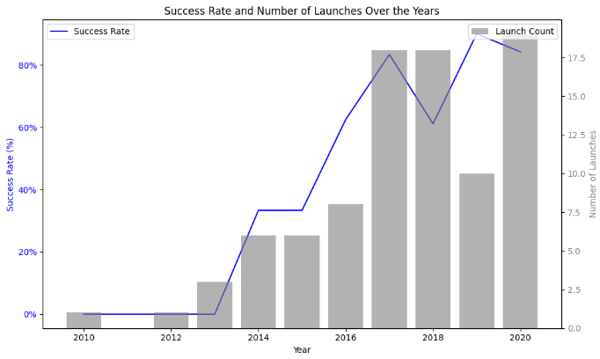
Launch Success Yearly Trend
As time passed the number of launches increased, as did the Success Rate, indicating improvements to the rockets and launch procedures were working.

Slide 24
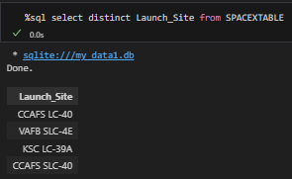
All Launch Site Names
The use of distinct allows us to view unique Launch Site values.

Slide 25
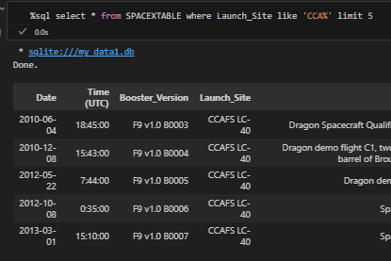
Launch Site Names Begin with 'CCA'
The five rows are filtered on Launch_Site containing starting with CCA by using the wildcard "%" at the tail of the string.
The use of limit 5 allowed only 5 rows to display.

Slide 26
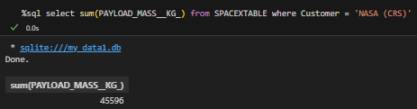
Total Payload Mass
The use of the sum() operator is used to get the total Payload Mass.
Customer is filtered to Nasa (CRS) within '' because it is looking for an exact string match.

Slide 27
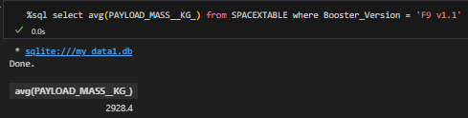
Average Payload Mass by F9 v1.1
The average Payload Mass is calculated using the avg() function.
Booster Version is filtered to F9 v1.1 within '' because it is looking for an exact string match.

Slide 28
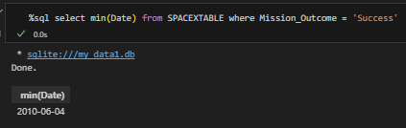
First Successful Ground Landing Date
The minimum Date is selected using the min() function.
Mission Outcome is filtered to Success within '' because it is looking for an exact string match.

Slide 29
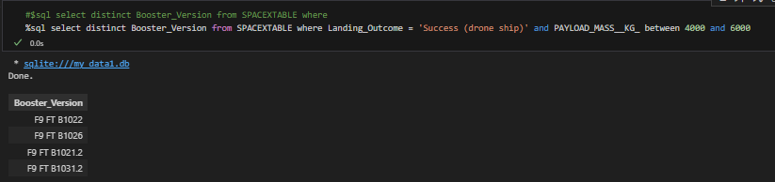
Successful Drone Ship Landing with Payload between 4000 and 6000
Distinct is used to get the unique values from Booster_Version.
Landing Outcome is equal to an exact match for Success (drone ship) and a Payload Mass (KG) between 4000 and 6000

Slide 30
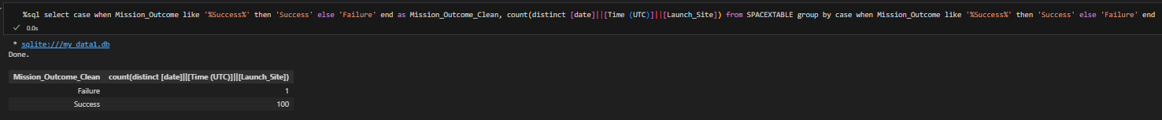
Total Number of Successful and Failure Mission Outcomes
A case when was created to identify any row with a string containing Success by using a wildcard "%". If a match was made the label Success was assigned, all others were assigned "Failure".
The use of count distinct concatination on Date, Time, and Launch Site was to ensure no duplicate rows were missed on using Date alone.
The group by was used to capture the case when column logic so the count() would execute without errors.

Slide 31
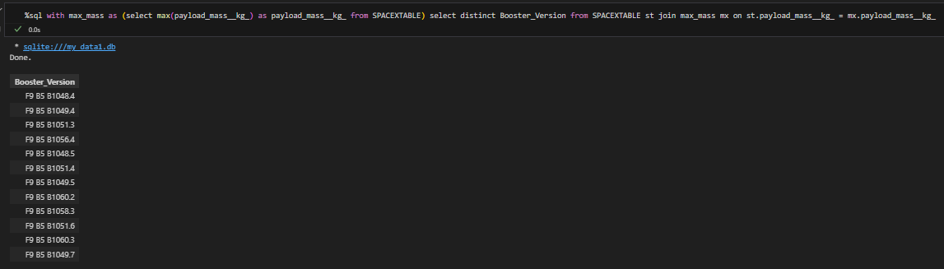
Boosters Carried Maximum Payload
A common table expression (CTE) was created to capture the max payload mass.
The CTE was joined back to the spacextable on Payload Mass (KG) to filter out rows that did not have the max mass.

Slide 32
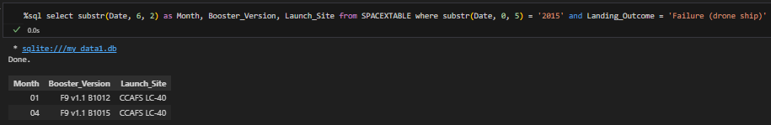
2015 Launch Records
The substring function was used to pull the Month from Date.
The substring function was used again to pull the year from Date in the Where
The and was used to add an additional filter
The SpaceXTable was filtered to Landing Outcomes equal to Failure (drone ship).

Slide 33
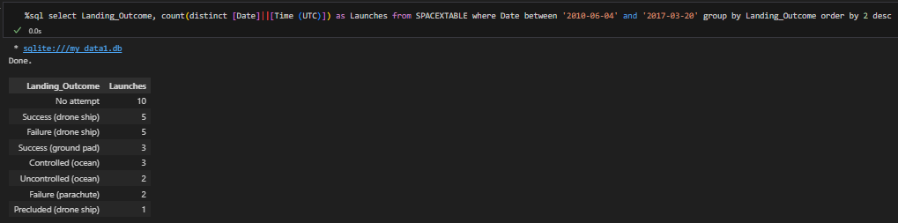
Rank Landing Outcomes Between 2010-06-04 and 2017-03-20
The count() was distinct for the concatination of Date and Time and grouped by the Landing Outcome
The table was filtered for Dates between 6/4/2010 and 3/20/2017
The output was ordered by the number of launches in descending order.

Slide 34

Section 3

Slide 35
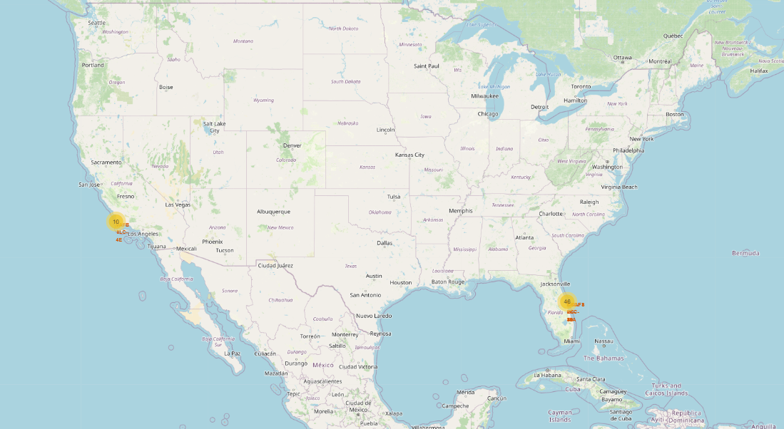
Map of Space X Launch Sites
All launch sites are south and along the coast.

Slide 36
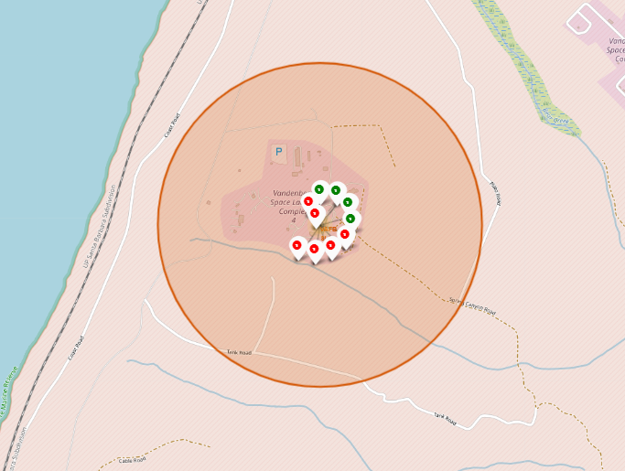
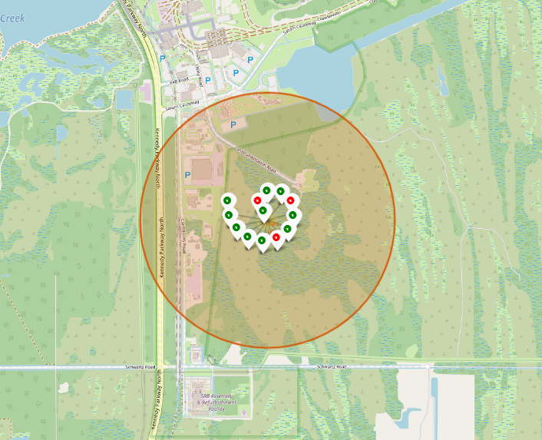
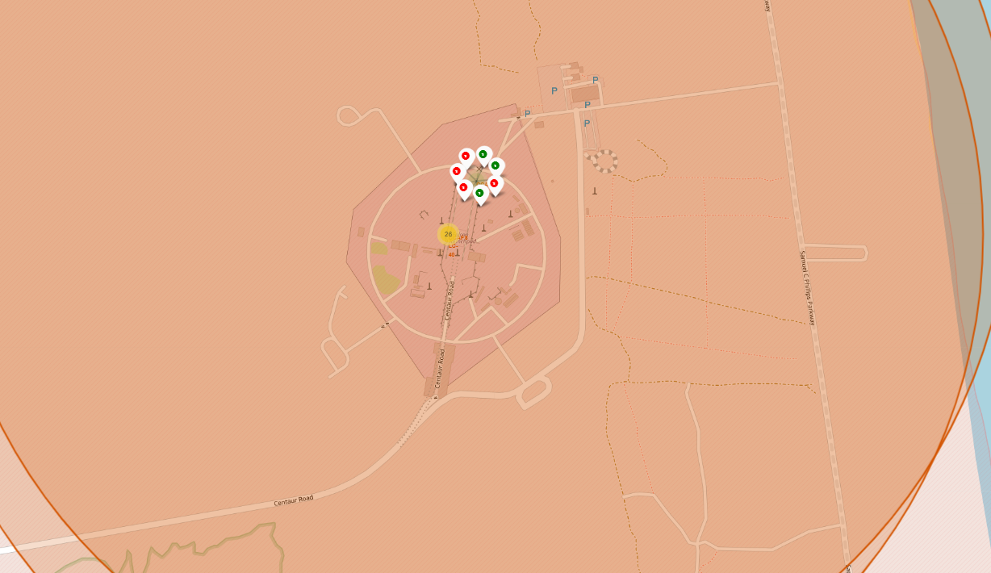
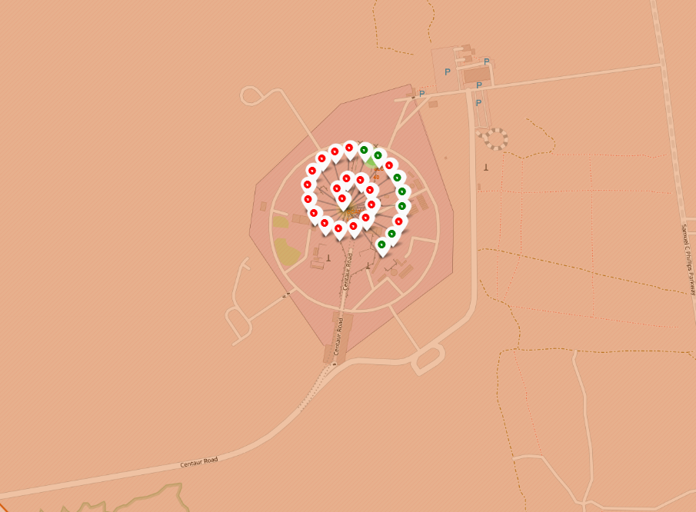
Space X Launch Site Success and Failure
Green indicates successful landings
Red indicates unsuccessful landings
Florida has significantly more flights than California

Slide 37

Section 4

Slide 38
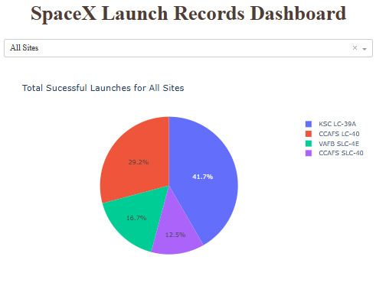
Total Successful Launches Pie Chart
KSC LC-39A had the most portion of successful launches
CCAFS SLC-40 had the smallest portion of success lauches

Slide 39
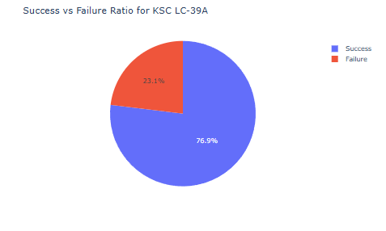
Lauch Success Ratio
The launch success ratio for the highest site number of successful launches.

Slide 40
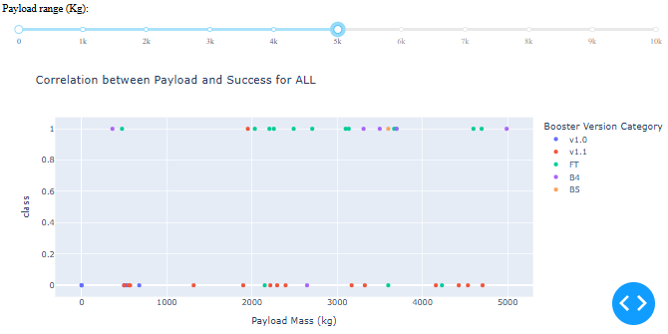
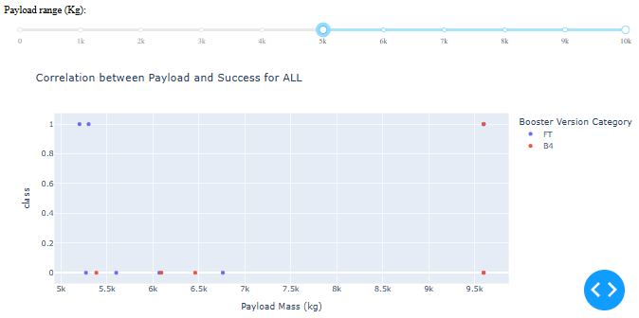
Payload Mass to Success
The lower the payload mass the higher the success.

Slide 41

Section 5

Slide 42
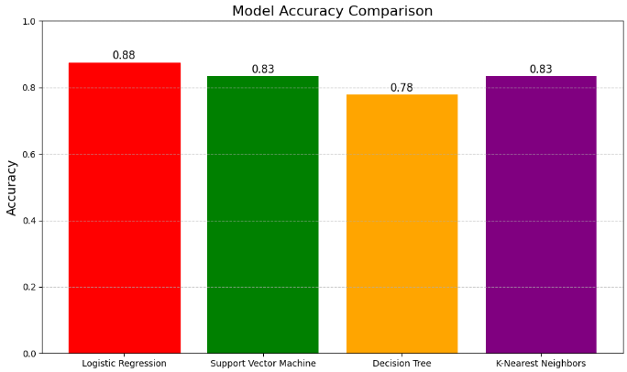
Classification Accuracy
The model with the highest accuracy was Logistic Regression.

Slide 43
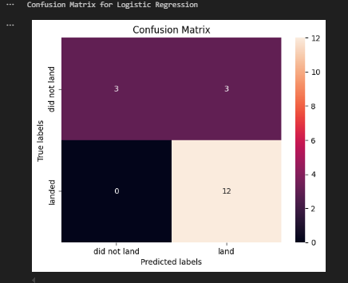
Confusion Matrix
The model performed well for identifying landed.
Adjustments to the model should be made for the "did not land" to reduce false positives.

Slide 44
Conclusions
Launch successes and the number of launches started to increase after 2017.
Lower orbit launches performed worse than high orbit launches.
Specific sites performed better than others however the total number of launches between sites is uneven.
Logistic Regression is the better performing model out of the four that were created.
Next steps, tune model to better adapt to missing information, adjust "did not land" class paramaters.

Slide 45


